Slide 1
Chapter 3 VHDL Basics
Dr. Ahmed Abou-Auf
Spring 2018

Slide 2
VHDL Lexical Elements
Identifier is the name of an object
Can only contain alphabetic letters, decimal digits and underscore, the last character cannot be an underscore, no two successive underscores
The first character must be a letter
Not a reserved word
Valid examples:
A10, next_state, NextState, mem_addr_enable
Invalid examples:
sig#3, _X10, 7segment, X10_, hi_ _there
Numbers:
Integer: 0, 1234, 98E7:
Real: 0.0, 1.23456 or 9.87E6
Base (2 – 16): 2#101101#
Character
‘1’, ‘0’
Strings
Text Strings: “Hello”
Bit strings: “1101”, B”1001”, O”372”, X”FAA0”

Slide 3
VHDL Objects
A named item that hold a value of specific data type
Four kinds of objects
Signal
Variable
Constant
File (cannot be synthesized)
Signal:
Declared in the architecture body's declaration section. Ports in entity declaration are considered as signals
Signal declaration:
signal signal_name, signal_name, ... : data_type;
Signal assignment:
signal_name <= projected_waveform;
Can be interpreted as wires or “wires with memory” (i.e., FFs, latches etc.)

Slide 4
VHDL Objects—cont.
Variable:
Declared inside a process or a function/procedure.
Variable declaration:
variable variable_name, variable_name, ... : data_type;
Variabe assignment:
variable_name := projected_waveform;
No direct hardware counterpart
Contains no “timing info” (immediate assignment)
Constant
Constant declaration:
constant const_name, ... : data_type := value_expression
Used to enhance readability
Example

Slide 5
Data Types
Definition of data type
A set of values that an object can assume.
A set of operations that can be performed on objects of this data type.
Frequently used data types:
Standard VHDL types
IEEE1164_std_logic package
IEEE numeric_std package
signed and unsigned has flexible operators and functions than std_logic_vectors
User-defined types

Slide 6
Standard VHDL types
integer:
range: -(2^31) to 2^31-1, two subtypes: natural, positive
Operators: +, -, *, /, abs, mod, rem, **
Real:
range: -(1.0E+38) to (1.0E+38)
Operators: +, -, *, /, abs, **
Time
Similar to integer but has units: fs, ps, ns, us, ms, sec, min, hr
Boolean:
(false, true)
Boolean expression Operators: and, or, not, xor, nand, nor, xnor
Relational operators returns boolean: =, >, >=, <, <=,
Bit:
‘0’, ‘1’
Operators: and, or, not, xor, nand, nor, xnor
Cannot be mixed with boolean: ‘0’ and true

Slide 7
IEEE std_logic_1164 package
New data type: std_logic, std_logic_vector
Replaces bit and bit_vector
std_logic:
– 9 values: ('U', 'X', '0', '1', 'Z', 'W', 'L', 'H', '-')
• '0', '1': forcing logic 0' and forcing logic 1
• 'Z': high-impedance, as in a tri-state buffer.
• 'L' , 'H': weak logic 0 and weak logic 1, as in wiredlogic
• 'X', 'W': “unknown” and “weak unknown”
• 'U': for uninitialized
• '-': don't-care.
std_logic_vector: an array of elements with std_logic data type
E.g.,
signal a: std_logic_vector(7 downto 0);
Need to invoke package to use the data type:
library ieee;
use ieee.std_logic_1164.all;
Overloaded Logical operators: and, or, not, xor, nand, nor, xnor

Slide 8
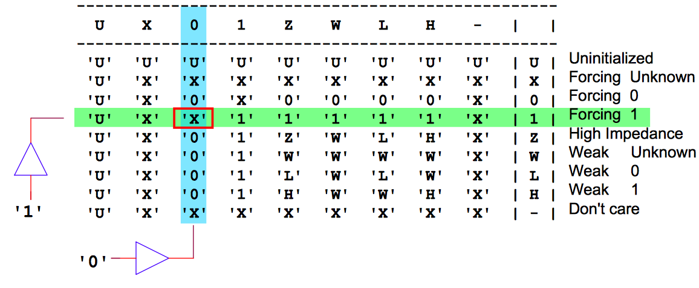
The std_logic type
is a resolved version of std_ulogic, this means there is a method to resolve the conflicts when one signal has multiple drivers

Slide 9
Overloaded operators for std_logic_1164 package

Slide 10
IEEE numeric_std package
Difficult to synthesize arithmetic operators from integer operands
signal a, b, sum: integer;
. . .
sum <= a + b;
IEEE numeric_std package: define integer as a an array of elements of std_logic
Two new data types: unsigned, signed
The array interpreted as an unsigned or signed binary number
E.g.,
signal x, y: signed(15 downto 0);
Need invoke package to use the data type
library ieee;
use ieee.std_logic_1164.all;
use ieee.numeric_std.all;

Slide 11
IEEE numeric_std package—functions

Slide 12
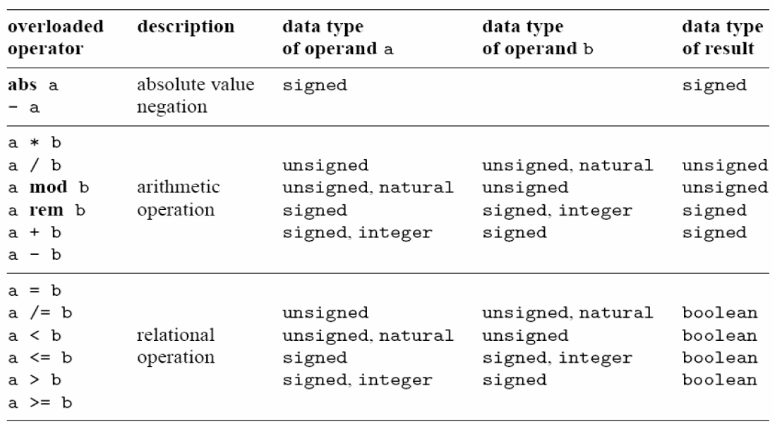
IEEE numeric_std package—operators.

Slide 13
VHDL Type Cast and Conversion Functions

Slide 14
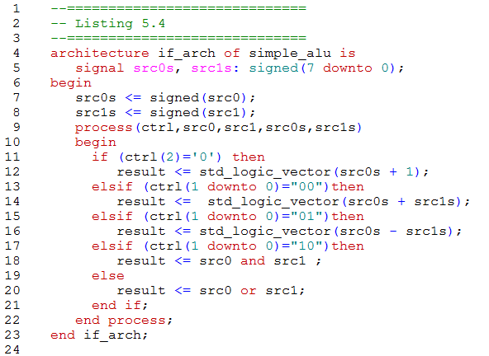
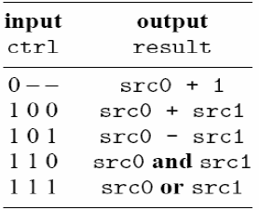
Example: Simple ALU

Slide 15
IEEE numeric_std package—examples
library ieee;
use ieee.std_logic_1164.all;
use ieee.numeric_std.all;
signal s1, s2, s3, s4, s5, s6: std_logic_vector(3 downto 0);
signal u1, u2, u3, u4, u6, u7: unsigned(3 downto 0);
signal sg: signed(3 downto 0);
– Ok
u3 <= u2 + u1; --- ok, both operands unsigned
u4 <= u2 + 1; --- ok, operands unsigned and natural
–Wrong
u5 <= sg; -- type mismatch
u6 <= 5; -- type mismatch
– Fix
u5 <= unsigned(sg); -- type casting
u6 <= to_unsigned(5,4); -- conversion function
–Wrong
u7 <= sg + u1; -- + undefined over the types
– Fix
u7 <= unsigned(sg) + u1; -- ok, but be careful
–Wrong
s3 <= u3; -- type mismatch
s4 <= 5; -- type mismatch
– Fix
s3 <= std_logic_vector(u3); -- type casting
s4 <= std_logic_vector(to_unsigned(5,4));
–Wrong
s5 <= s2 + s1; + undefined over std_logic_vector
s6 <= s2 + 1; + undefined
– Fix
s5 <= std_logic_vector(unsigned(s2) + unsigned(s1));
s6 <= std_logic_vector(unsigned(s2) + 1);

Slide 16
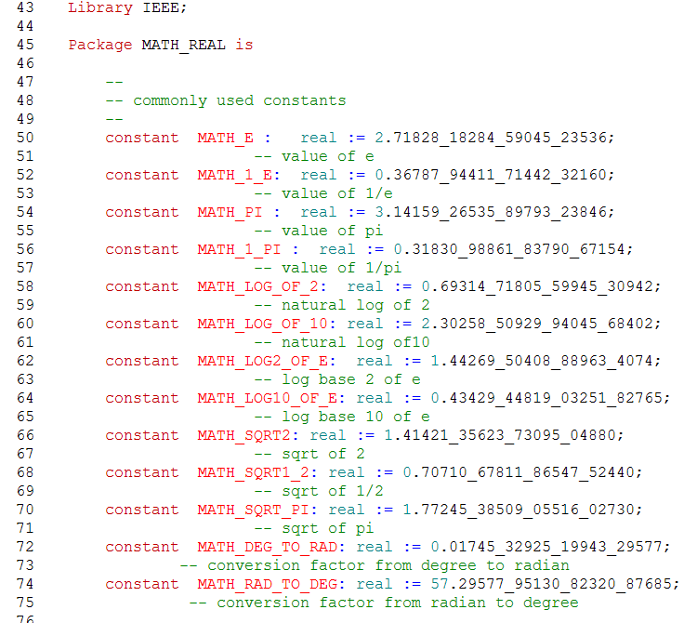
IEEE math_real—commonly used constants

Slide 17
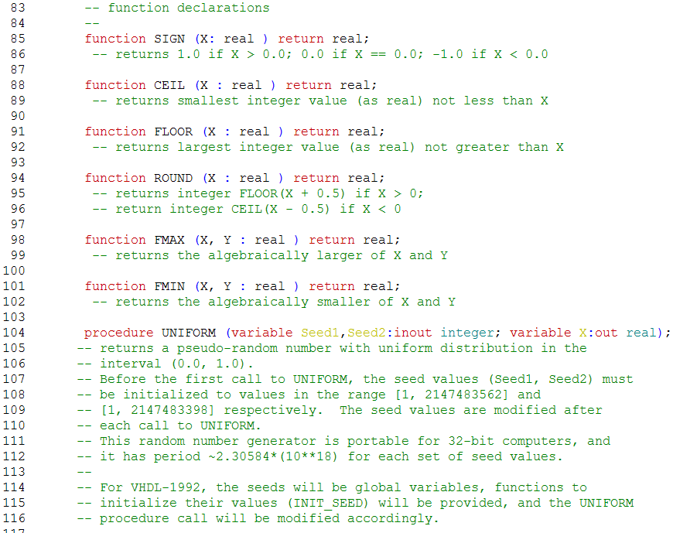
IEEE math_real—functions

